Slide 1

I Said Unrelational, Not Illogical—Exercises in Database Design
Colleen Dunlap
@ColleenDHere

Slide 2
Agenda
Introduction
History of Databases
SQL and NoSQL Structures
Tooling
Queries
Pros and Cons—SQL vs NoSQL
Scaling
Combining SQL/NoSQL
Summary
Q&A

Slide 3





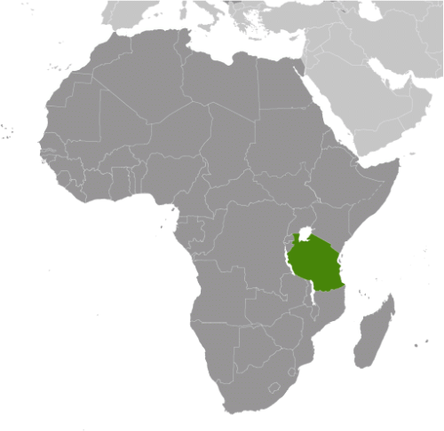
Obligatory “About Me” Slide

Slide 4
Your Turn!
Turn to your Nearest Neighbor
Name
Pronouns
Position
Hobbies
Hogwarts House
Why You’re Here Today
Favorite Pasta Variety

Slide 5

First, Some Database History…

Slide 6
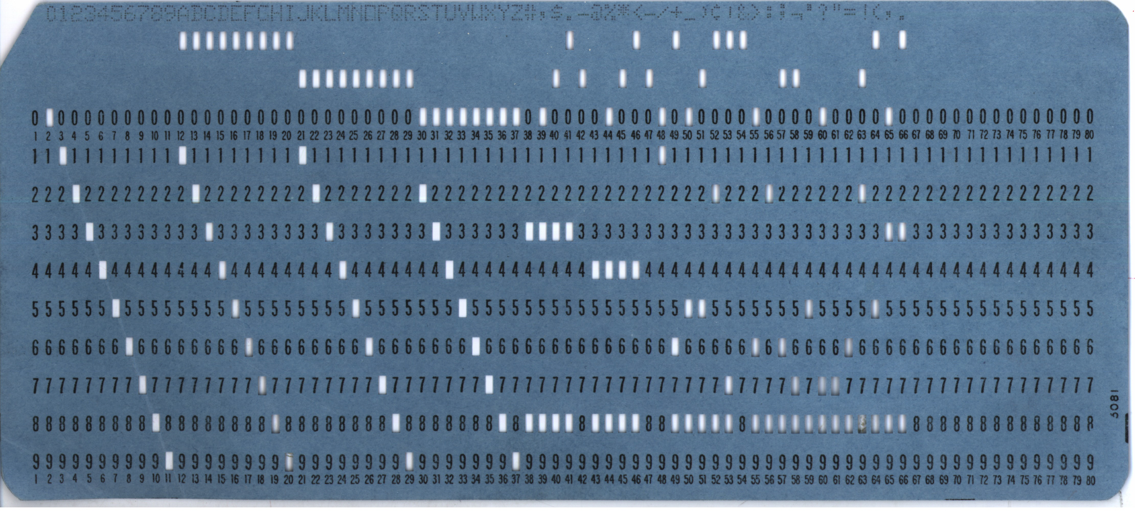
The First Databases
70 Bytes
10 million a day by IBM—only 670 MB!
Reality until the 1950s…

Slide 7
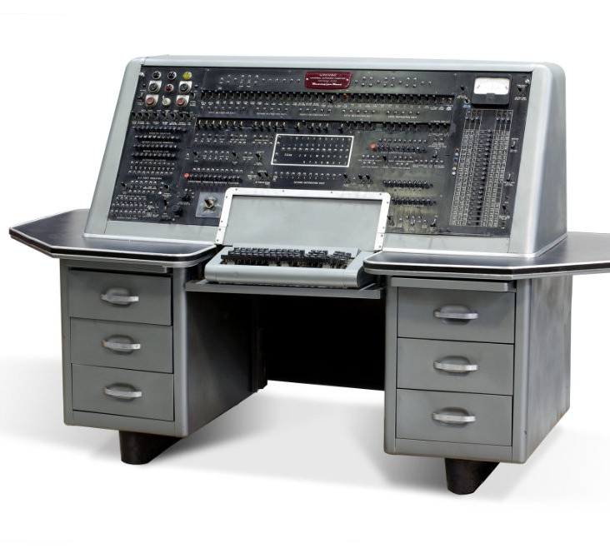
1950s—Enter the Digital Computer
Computers were Really Big Calculators
Data was the leftovers

Slide 8
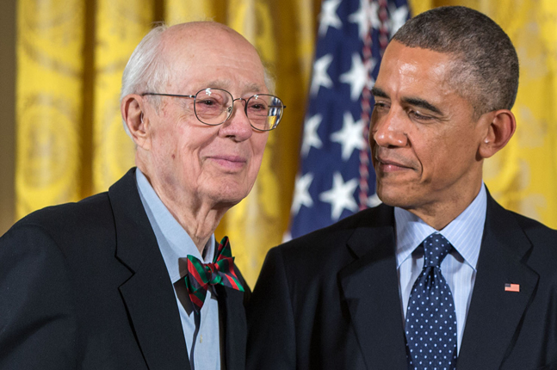
The First DBMS
DBMS == Database Management System
Charles Bachman
1960 Integrated Data Store (IDS)
Mid 1960s—CODASYL
Navigational Database
IBM and IMS

Slide 9

Here Comes Relational…
Edgar Codd
Worker at IBM
“table with fixed-length records.”
INGRES
Michael Stonebraker and Eugene Wong
QUEL
Pressure was On
IBM developed our beloved SQL in 1974

Slide 10

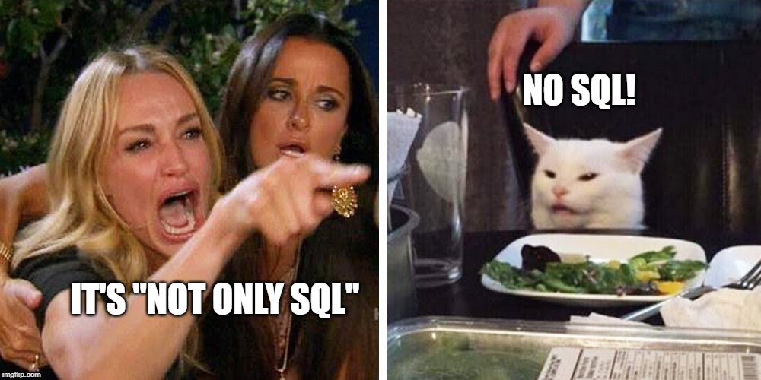
New Kids On the Block—NoSQL
Term Coined in 1998
Carlo Strozzi
Database that didn’t use SQL
Became a Twitter Hashtag in 2009
Eric Evans
Spurred by Internet
Un/Semi-structured Data
Faster Speed
Higher Volume
3Vs of Big Data
Velocity
Volume
Variety

Slide 11

That’s Cute. But What the Hecc Are these?

Slide 12
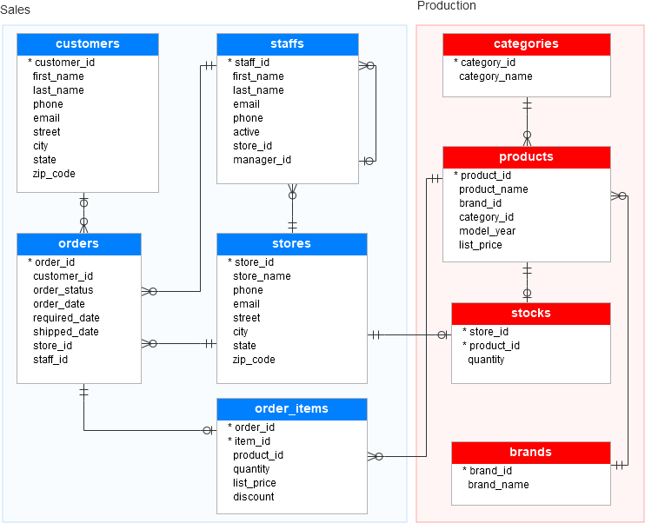
So… What Does SQL Look Like
Tables
Primary/Foreign Keys
Nomalization

Slide 13
Parking Ticket Example, SQL
Tickets issued
Owner of car
Every Month, Ticket Price Increases
City Needs to Know
When to Increase Price of Ticket
How Many Outstanding Tickets Does an Owner Have?
How Would You Implement this in SQL?

Slide 14
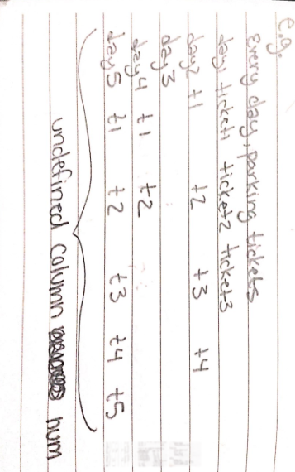
Parking Ticket Example, SQL

Slide 15
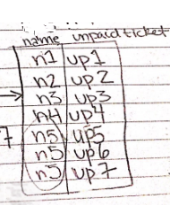
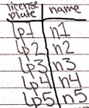
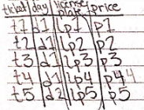
Parking Ticket Example, SQL

Slide 16
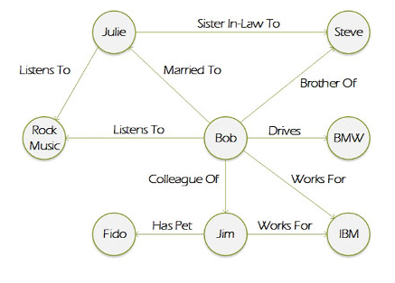
And… What Does NoSQL Look Like?
A lot of Different Stuff
Graph Databases
Column Stores
Key-Value Pairs
Documents
Objects

Slide 17
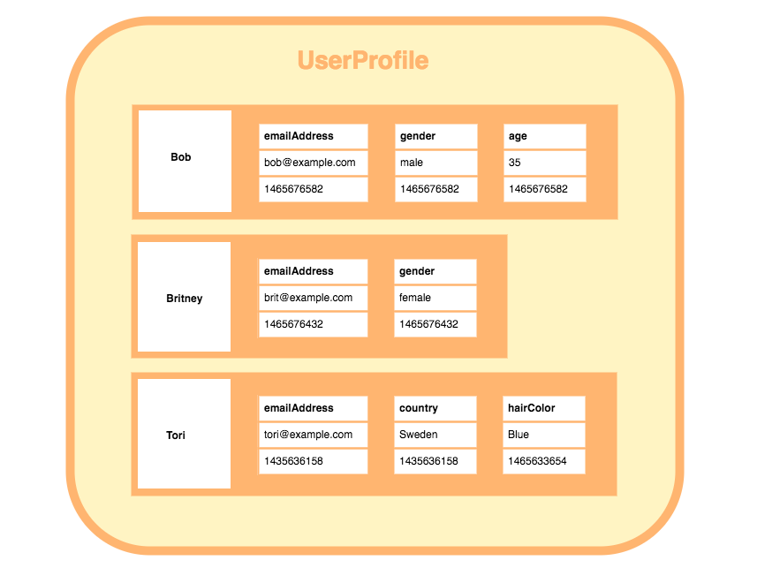
And… What Does NoSQL Look Like?
A lot of Different Stuff
Graph Databases
Column Stores
Key-Value Pairs
Documents
Objects

Slide 18
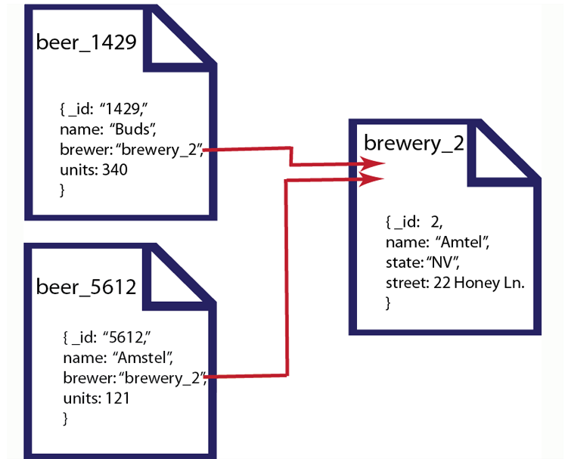
And… What Does NoSQL Look Like?
A lot of Different Stuff
Graph Databases
Column Stores
Key-Value Pairs
Documents
Objects

Slide 19
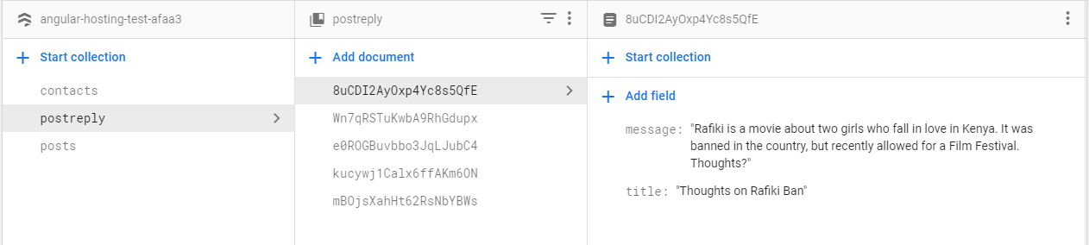
And… What Does NoSQL Look Like?
Google Firebase

Slide 20
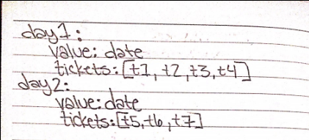
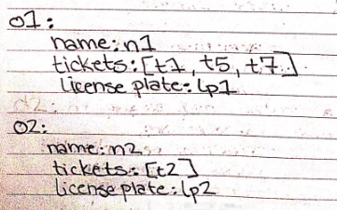
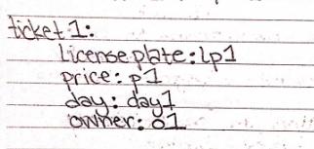
Parking Ticket Example, NoSQL

Slide 21











SQL Tools NoSQL Tools

Slide 22
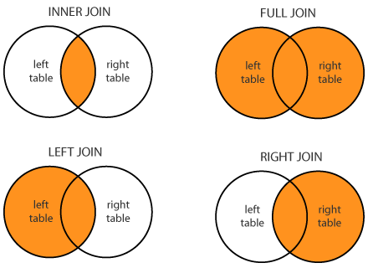
SQL Queries
SELECT <column names> FROM <table A>
SELECT<column names> FROM <table A> WHERE <condition> INNER JOIN <table B> ON <A.key = B.key>

Slide 23
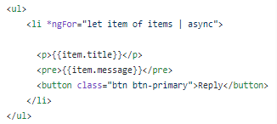
NoSQL Queries

Slide 24

So Which Do We USE???

Slide 25

Step One: Look at Your Data
SQL
Transactional Data
NoSQL
Object
User Data
Graphical
Subject to Change?

Slide 26

Step Two: Look at Your Data’s Size
Scalabaility!!
NoSQL better suited for Big Data

Slide 27

Step Three: Look at Your Development Context
Legacy Code
Existing Infrastructure
Budget
Security Requirements
Team Expertise
Common Case vs Uncommon Case

Slide 28
Example 1
Talk to your neighbor!!!
Emergency Medical Record
Patient Data
Office Visits
Hospital Visits
Prescriptions
Diagnoses

Slide 29
Example 2
Stock Market Sells and Purchases
Real Time Feed of Sells and Purchases
Meta Data on Each Company
Data Which Companies Own Which Companies
Share Sells
Share Buys

Slide 30
Ok, What About Scaling?

Slide 31

Vertical Scaling
Adding more resources to a single “Node” (or server)
Neighborhood Example
Pros
No Need for Distribution
Cons
Has a Limit (Leaning Tower of Pizza)
Single Point of Failure

Slide 32

Horizontal Scaling
Adding more nodes (servers)
Neighborhood Example
Pros
Limitless
Cons
Design Cross-Node Communication

Slide 33

Combining the Two: The “Not Only” in NoSQL

Slide 34
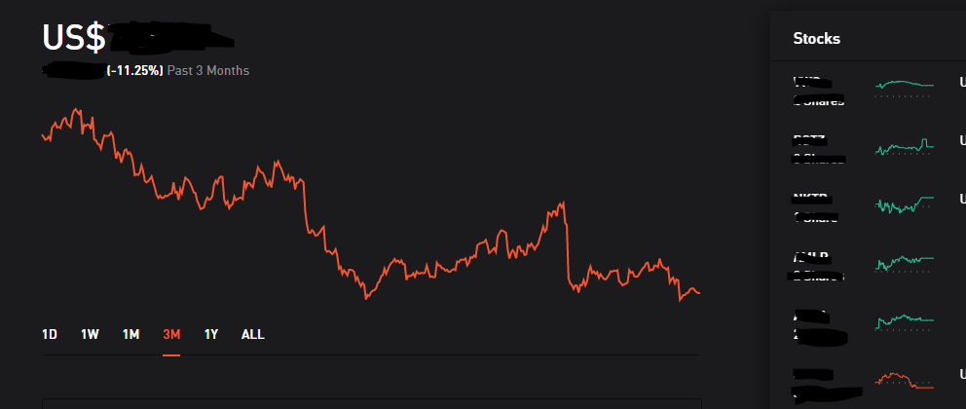
In Memory Cache
Stock Transactions Come in by the ms
Often, graphs on trading websites show aggregated historical trends

Slide 35



In Memory Cache
Stock Transactions Come in by the ms
Often, graphs on trading websites show aggregated historical trends
User Interface
Historical Trend Data
Real-Time Market Data

Slide 36
Table Fields in NoSQL Objects
Company A{
Name: “Amazon” Founded: 1994
Brands: [“Azure”, “Kindle”, “FireTV”]
StockTransactions: [Pointer to/Index in SQL Table]
}
Company | Buy/Sell | Shares | Price | Date
AMZN | BUY | 2 | $1,739.49 | 11/15/2019
… | … | … | … | …
… | … | … | … | …

Slide 37
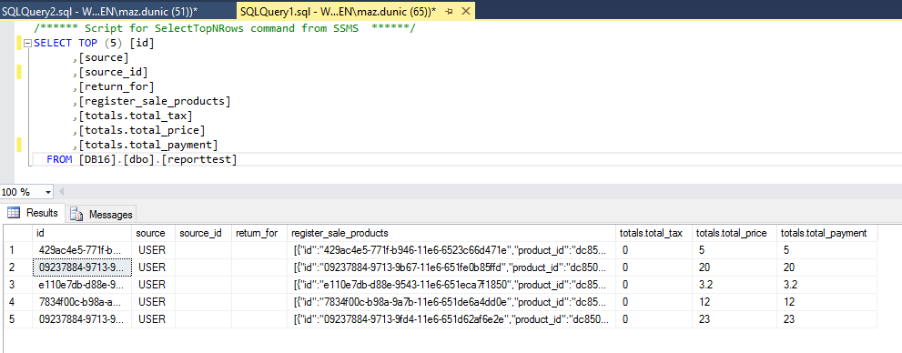
JSON in SQL Columns
Fields that Change Schema Often
E.g. Neural Network Parameters

Slide 38

Or Just Get Two Databases
Shutterfly Example
Image Data—NoSQL
Billing Data—SQL
Best when Data in Two DBs has little relation
Billing Data
Login
User id
Image Data

Slide 39
Conclusions/Lose Ends
“Which One’s Faster?” is a bad standalone question
NoSQL came to meet the needs of the Web
Semi-structured Data
Storage Size
Query Speed
Vertical Scalability has a limit
Get Creative, ask Why Not Both?
Remember, Coding is Fun
Notes:
SQL Good For—Transactional Data of Manageable Size
NoSQL Good For Big Data, even if your data isn’t as object oriented. Sometimes just the natural option

Slide 40

Thank You!
Twitter: @ColleenDHere
GitHub: github.com/colleenDunlap
Email: colleen85052@gmail.com
LinkedIn: lol, just email me please
Medium: @colleen85052
Interested in Marquette Energy Analytics? Email:
thomas.quinn@marquetteenergyanalytics.com

Slide 41
References
https://www.geeksforgeeks.org/sql-vs-nosql-which-one-is-better-to-use/
https://www.telerik.com/blogs/decide-neo-blue-pill-red-pill
https://www.dataversity.net/brief-history-database-management/
http://dbmswork.blogspot.com/2008/03/navigational-dbms.html
https://www.youtube.com/watch?v=dkhOZOmV7Fo
https://www.youtube.com/watch?v=wte3dmk8fmc
https://www.youtube.com/watch?v=EfMIWTnbhGw
https://www.youtube.com/watch?v=xpDnVSmNFX0
https://database.guide/what-is-a-column-store-database/
https://whatis.techtarget.com/definition/graph-database

